Slide 1
Power BI Embedded
FSI CSU SWARM

Slide 2
Hands-On Module

Slide 3
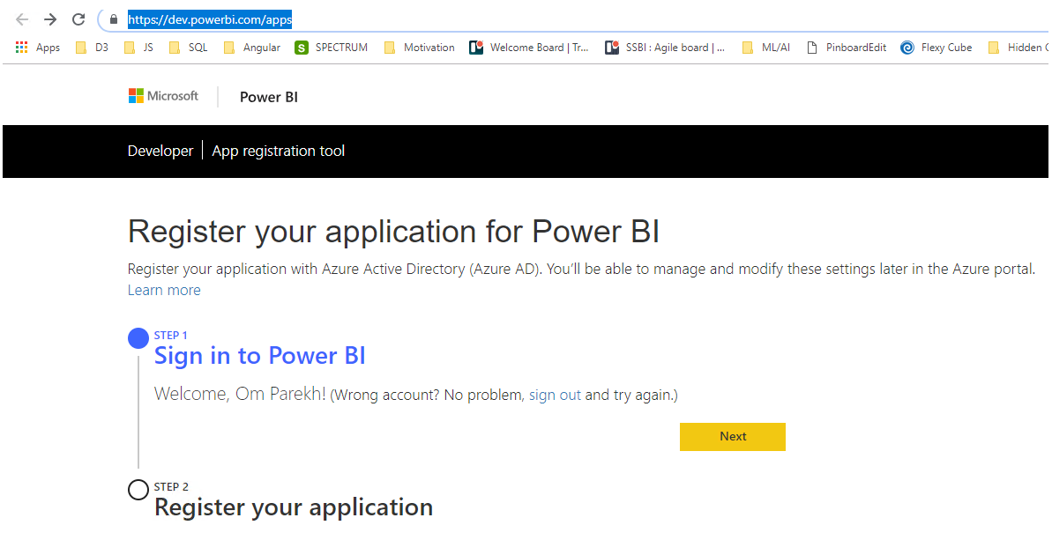
App Registration Tool
Step 1: Sign in to Power BI’s developer portal to register your application
https://dev.powerbi.com/apps

Slide 4
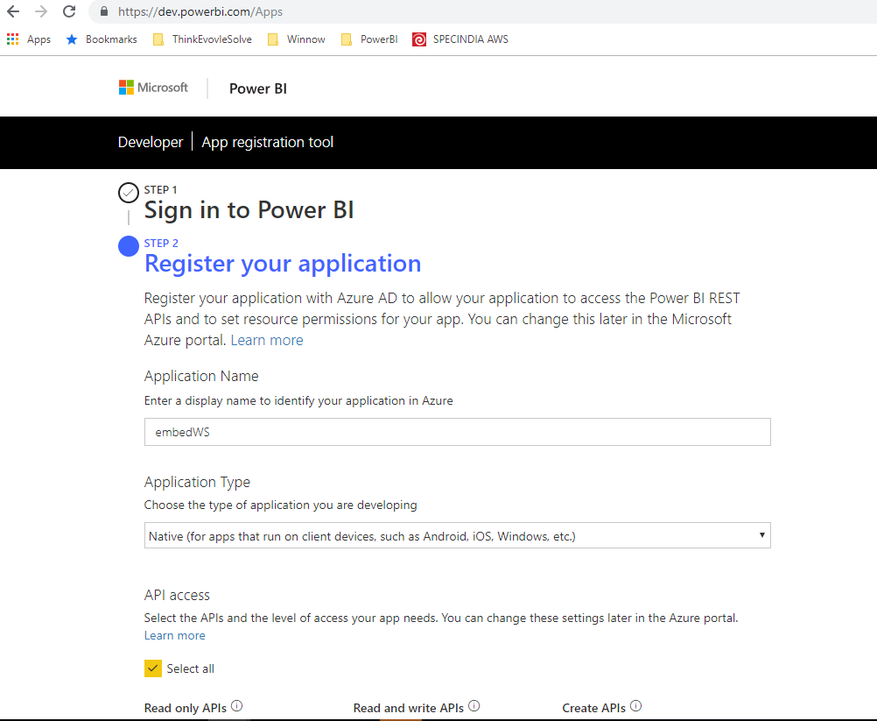
App Registration Tool
Step 2: Register your app by filling in the required fields
Remember the values for Application Name and Client ID
Example Client ID : 7114bf2f-8aad-49ad-8a7c-2e80e9b6fbba

Slide 5
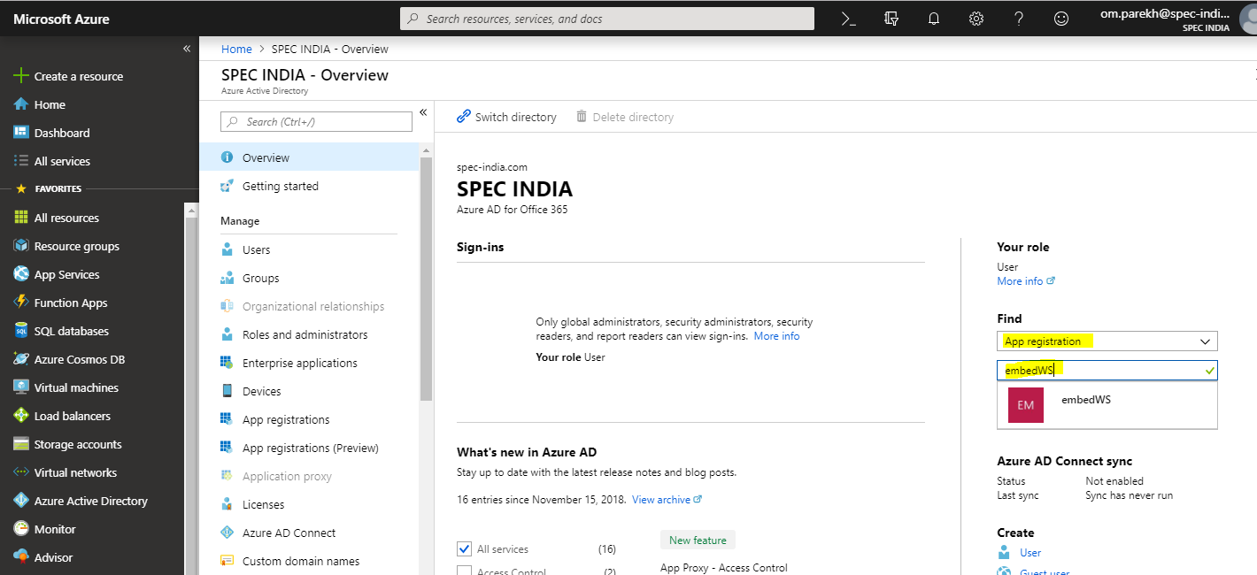
Grant Permission
Open the Azure Portal using the same Power BI Pro account used to register the application
Navigate to: Azure Active Directory
Setting ->
Required Permission ->
Grant Permission (select All)

Slide 6
Power BI
Go to Power BI App (app.powerbi.com)

Slide 7
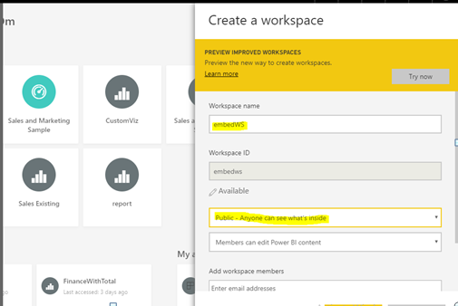
Power BI
Create Workspace
Note : Workspace name should match with application name we defined in azure portal.

Slide 8
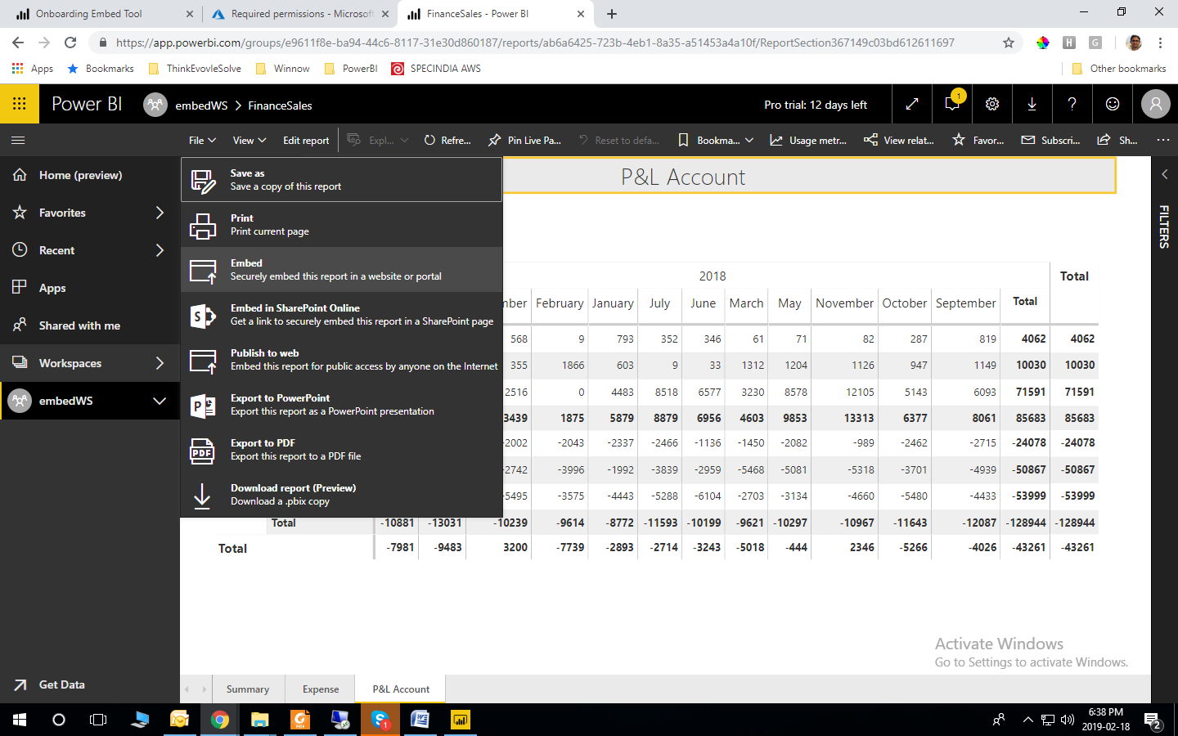
Power BI
Published the Power BI report in workspace we just created in above steps.
Open Power BI Report and click on File->Embed

Slide 9
Power BI
Copy the URL from the popup window.
Embed URL : https://app.powerbi.com/reportEmbed?reportId=ab6a6425-723b-4eb1-8a35-a51453a4a10f&groupId=e9611f8e-ba94-44c6-8117-31e30d860187
Report ID = ab6a6425-723b-4eb1-8a35-a51453a4a10f
Group ID = e9611f8e-ba94-44c6-8117-31e30d860187
Remember the values for
Embed URL
Group ID
Report ID

Slide 10
REST API
Call REST API to open Power BI report securely

Slide 11
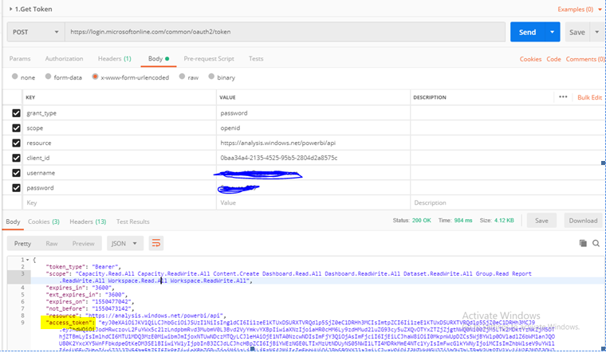
REST API
Call GetToken REST API with header and body
https://login.microsoftonline.com/common/oauth2/token
Header
Content-Type = application/x-www-form-urlencoded
Remember the values for Access Token from result

Slide 12
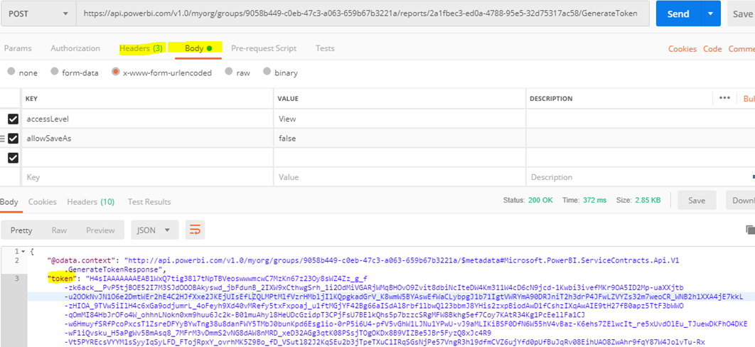
REST API
Generate embed token using below REST API
https://api.powerbi.com/v1.0/myorg/groups/<<GROUP ID>>/reports/<<REPORT ID>>/GenerateToken
Header
Authorization = Bearer <<Access Tocken>>
Content-Type = application/x-www-form-urlencoded
Accept=application/json
BODY
accessLevel = View
allowSaveAs=false
Remember Token from the result
Embed token

Slide 13
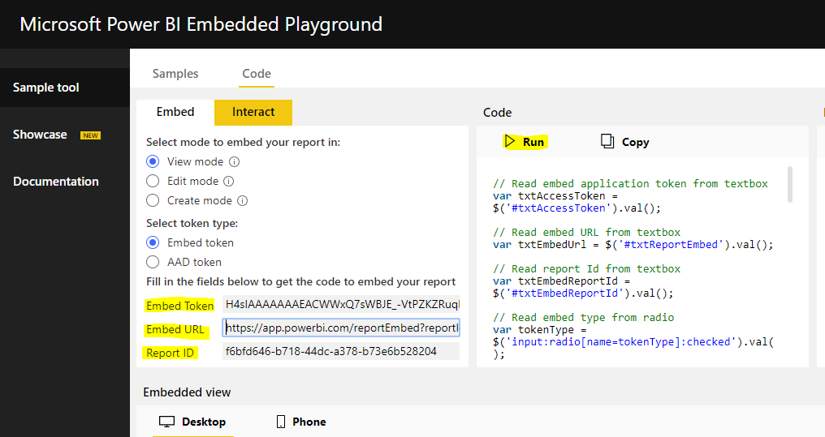
Attached Power BI Report in App
We have following items
Embed Token
Report ID
Group ID
Call Power BI Report using Microsoft Utilities
https://microsoft.github.io/PowerBI-JavaScript/demo/v2-demo/index.html

